Slide 1
TITLE
APPLIANCES ENERGY PREDICTION
By R.Srivalli

Slide 2
INDEX
Table of Contents | Slide no.
Abstract | 3
Architecture Diagram | 4
Modules | 5
Implementation | 7
Output Screens | 10
References | 15

Slide 3
ABSTRACT
The Energy Consumption Prediction for Home Appliances project aims to develop a predictive model for forecasting energy consumption in households. With the increasing awareness of energy efficiency, this project focuses on providing a tool that enables users to estimate the energy consumption of their home appliances. The system utilizes machine learning techniques, specifically linear regression, to analyze historical energy usage data and predict future consumption. The user-friendly graphical user interface (GUI) allows users to upload their energy usage dataset in CSV format. The application preprocesses the data, excluding irrelevant variables, and trains a linear regression model on the remaining features. Once the model is trained, users can input new data points, and the system provides predictions for energy consumption. The predictions are displayed through a user-friendly interface, enhancing accessibility for non-technical users.

Slide 4
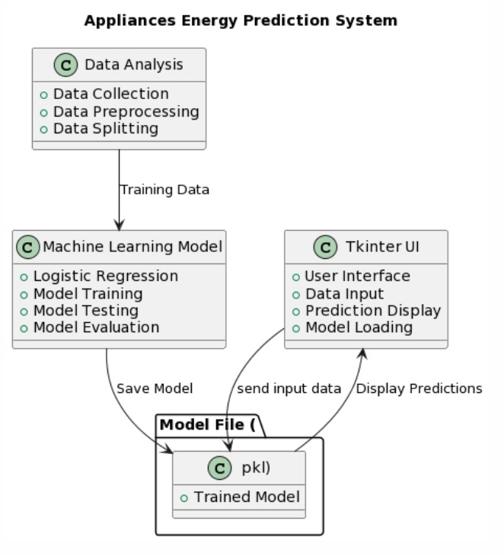
ARCHITECTURE DIAGRAM

Slide 5
MODULES
Pandas: Used for data manipulation and analysis. It provides data structures like DataFrame to work with structured data efficiently.
Numpy: Numpy is a fundamental package for scientific computing in python. It provides support for multidimensional arrays and matrices, along with mathematical functions to operate on these arrays.
Sklearn: This library is used for data preprocessing, model selection, training, evaluation and more.
Tkinter: Tkinter is a standard GUI(Graphical User Interface) library for python. It is used to create windows, labels, buttons and other GUI elements.

Slide 6
MODULES
PIL:PIL(Python Imaging Library) is used for image processing tasks. In this context, it is used to handle images for GUI elements.
Matplotlib:Matplotlib is a plotting library used to create visualizations, such as line plots, histograms, scatter plots etc.
Seaborn:Seaborn is another data visualization library that works on top of Matplotlib, providing a higher-level interface for drawing attractive and informative statistical graphics.

Slide 7
IMPLEMENTATION
Algorithm:
# Linear Regression Algorithm Pseudo-code
# Step 1: Initialize Parametersinitialize_coefficients()
# Step 2: Input Dataload_data(training_data)
# Each data point (x_i, y_i) represents a pair of observations
# Step 3: Split Data (Optional)train_set, test_set = split_data(training_data, split_ratio)
# Optional step to scale input features
# Step 4: Model Trainingtrain_model(train_set)
# Adjust coefficients using training data
# Step 5: Predictionpredictions = predict(test_set)
# Apply the trained model on the testing set
# Step 6: Evaluationevaluation_metrics = evaluate(predictions, test_set)
#Evaluate model performance
use the model for real-time predictions

Slide 8
IMPLEMENTATION
def train_model(self, X, y):
X_train, _, y_train, _ = train_test_split(X, y, test_size=0.2, random_state=42)
model = LinearRegression()
model.fit(X_train, y_train)
return model

Slide 9
IMPLEMENTATION
def predict_energy(self):
try:
if not hasattr(self, 'data'):
messagebox.showerror("Error", "Please load a dataset first.")
return
X = self.data.drop(['date', 'Appliances'], axis=1)
y = self.data['Appliances']
model = self.train_model(X, y)
new_data_point = self.data.drop(['date', 'Appliances'], axis=1).iloc[0:1]
new_pred = model.predict(new_data_point)
messagebox.showinfo("Prediction", f"Predicted Energy Consumption: {new_pred[0]:.2f} kWh")
except Exception as e:
messagebox.showerror("Error", f"An error occurred: {str(e)}")

Slide 10
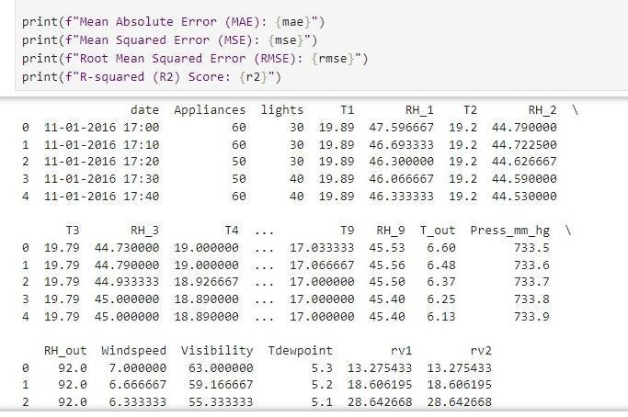
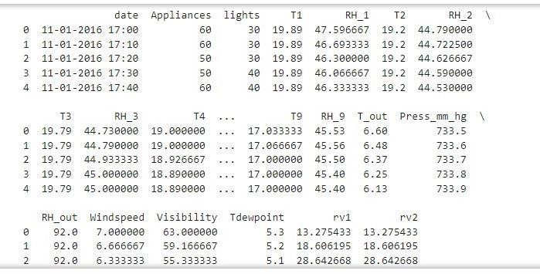
OUTPUT SECREENS

Slide 11
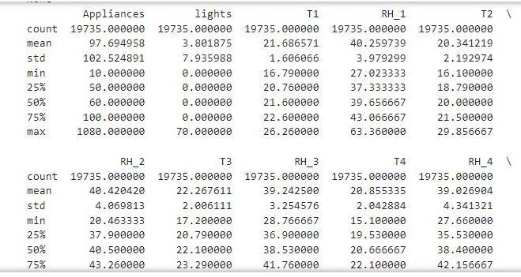
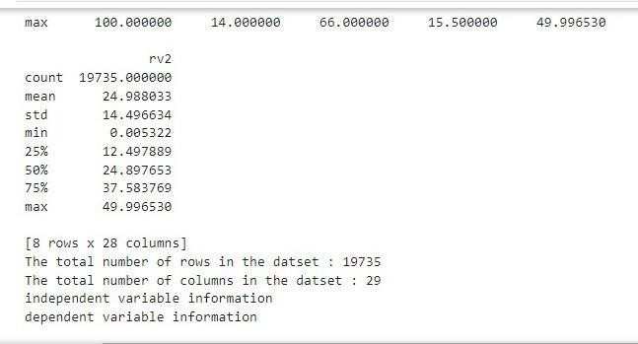
OUTPUT SCREENS

Slide 12
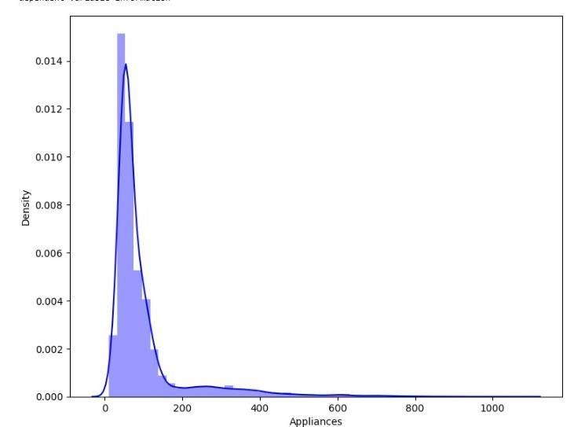
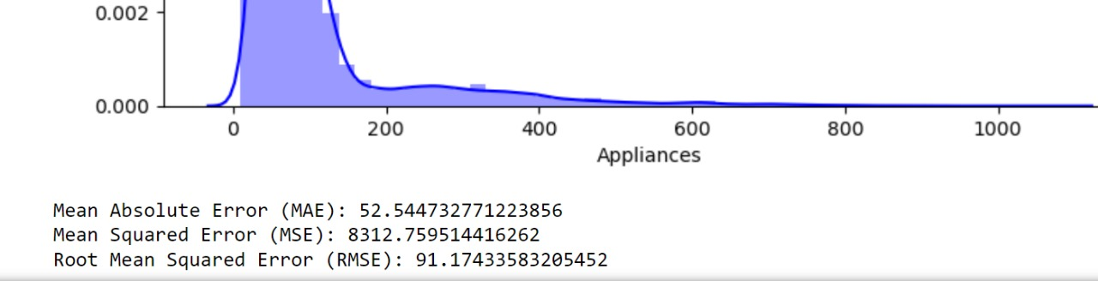
OUTPUT SCREENS

Slide 13
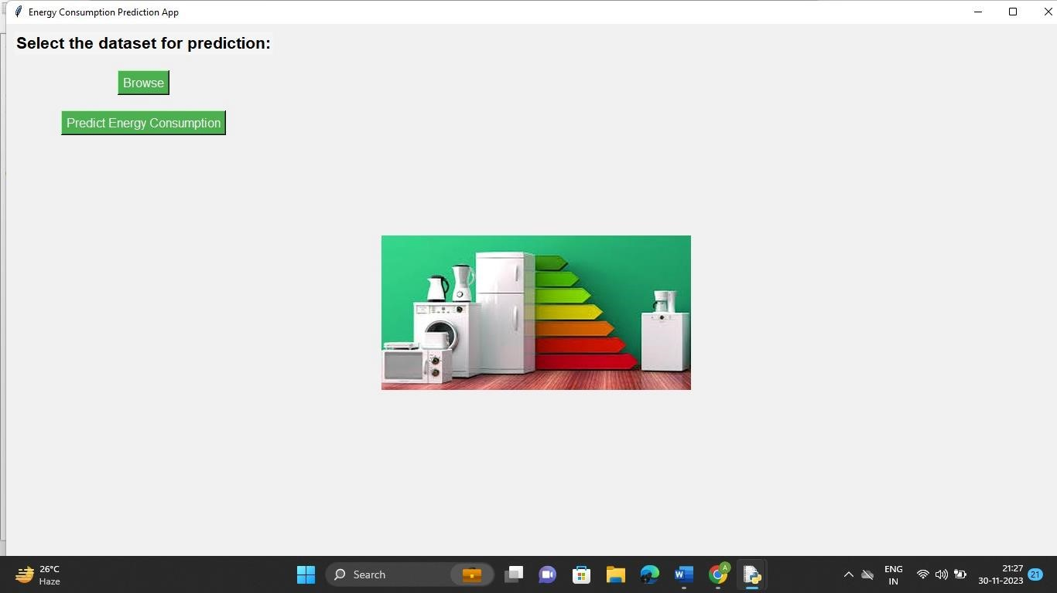
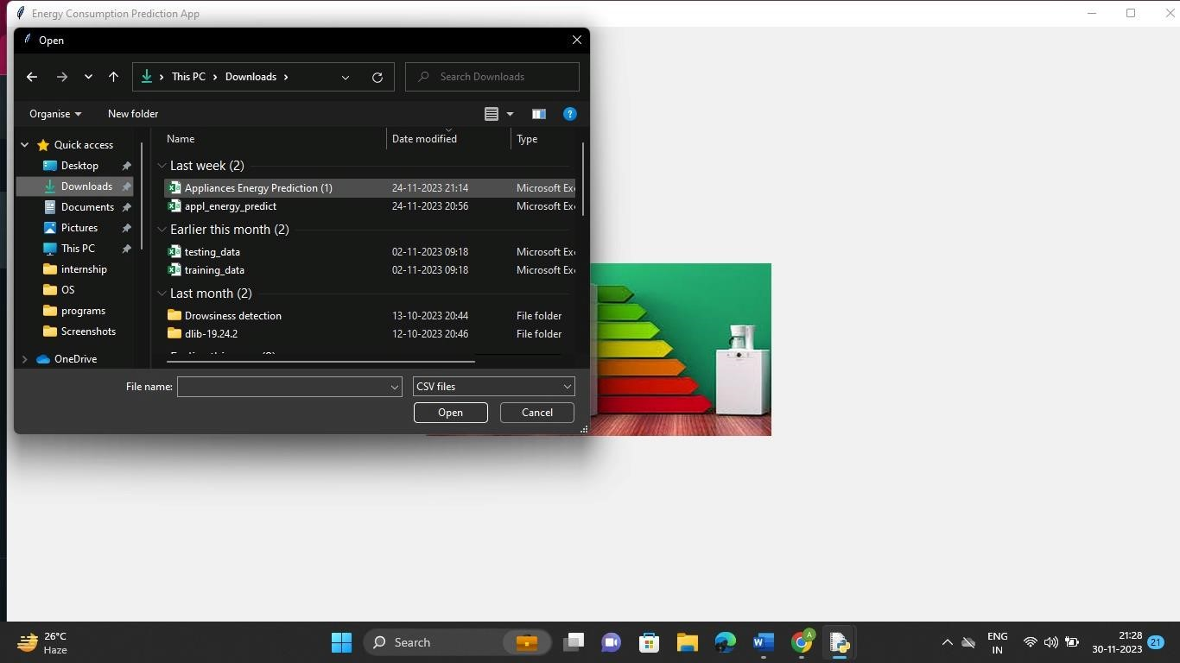
OUTPUT SCREENS

Slide 14
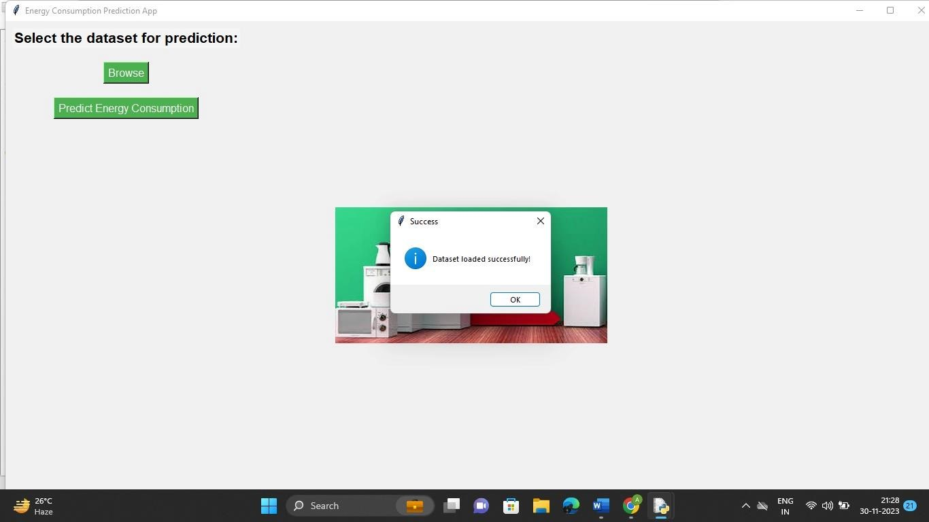
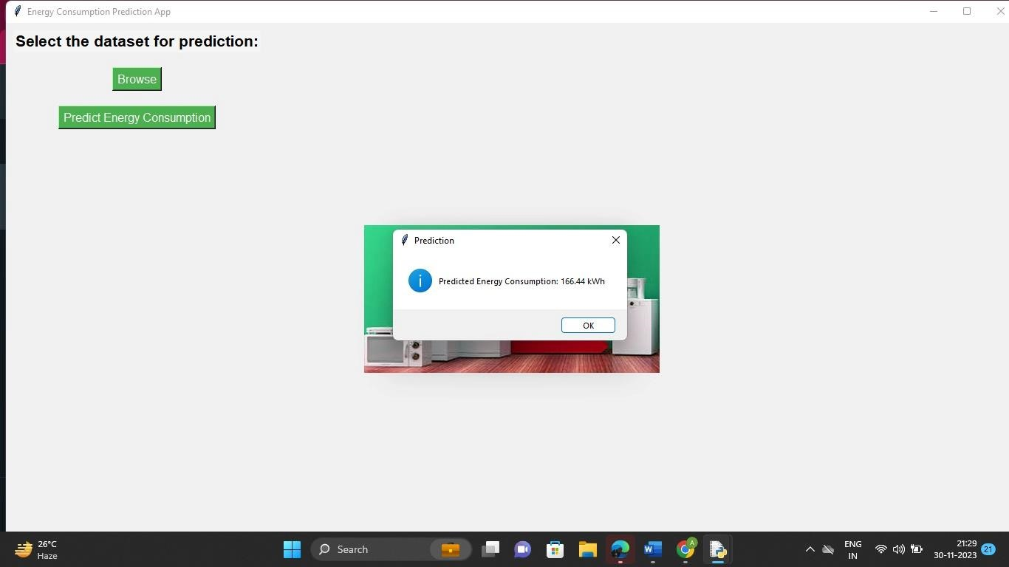
OUTPUT SCREENS

Slide 15
REFERENCES
[1] Xiao, X.R., Hu, S., Yan, D. (2012) Research on Electric Model of Household Appliances Based on Actual Measurement. Building science, 28:223–231.
[2] Jian, H.Y., Kong, W.J., Liu, H.X. (2013) Study on Influences of Lighting and Appliances Usage Behavioral Patterns on Household Electricity Consumption. Building science, 29:15–19.
[3] Chen, S.Q., Li, N.P., Fu, X.Z. (2007) Statistical methods of energy consumption for residential buildings. Heating Ventilation &Air Conditioning, 37:44–48.
[4] Zhou, J., Song, Y.L. (2018) Study on the residential Thermal Environment and Energy Consumption Based on Human Occupancy. Building science, 34:59–65.

Slide 16
THANK YOU

